Slide 1
Introduction to PHP

Slide 2
Server Side Techniques
Server side scripting requires installation on the server side
Scripts generate the html to the browser
Does not require any installations or add-ons on the client

Slide 3
PHP: HYPERTEXT PREPROCESSOR

Slide 4
Introduction to PHP
PHP is a computer scripting language.
Originally designed for producing dynamic web pages
Appeared in 1995
PHP Group is responsible for the language, no formal specification
Free software
Runs on most operating systems and platforms
URL: http://www.php.net

Slide 5
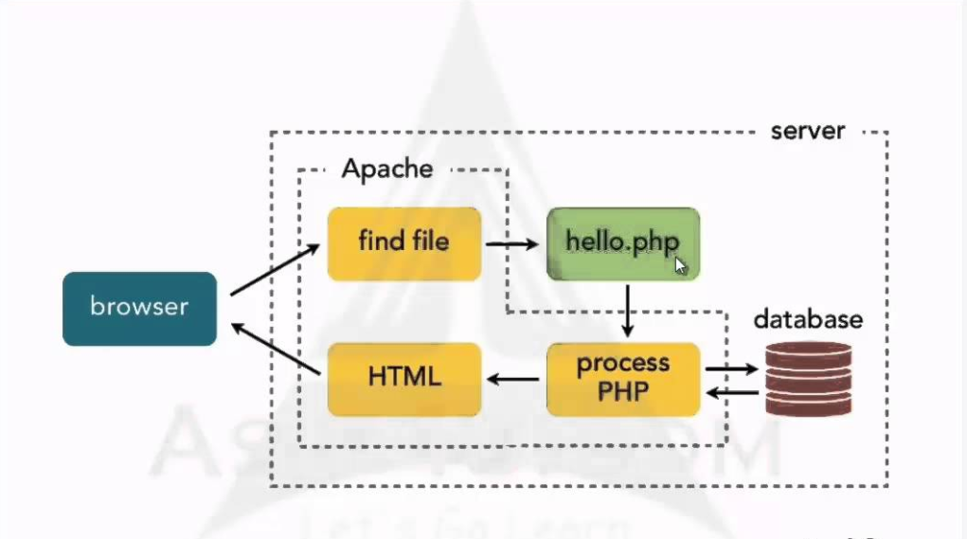
Response

Slide 6
Introduction to PHP Syntax
PHP has quite easy syntax, if you are familiar with any c-type language
It has all the same structures that you are familiar with other programming languages
PHP is designed to output to browser, but it is possible to do also CLI apps.

Slide 7
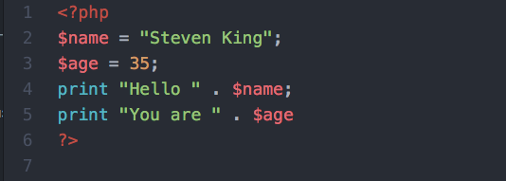
Example
<?php
$name = ”Steven King”;
$age = 35;
print "Hello " . $name;
print “You are “ . $age
?>

Slide 8
Variables
Variables in PHP are represented by a dollar sign
PHP supports eight types:
  boolean, integer, float, double, array, object, resource and NULL

Slide 9
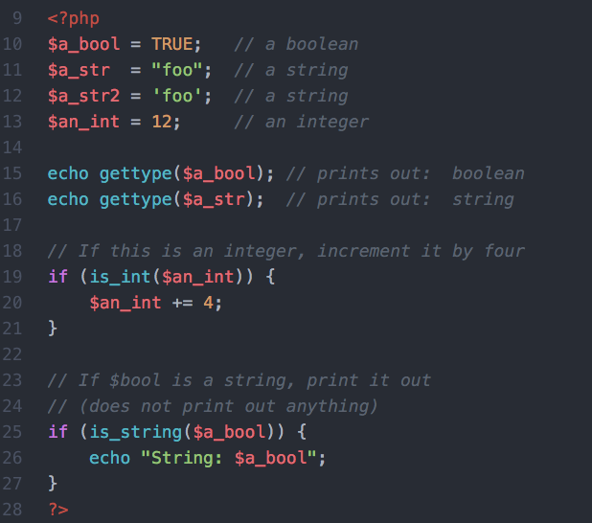
Example (php.net)
<?php
$a_bool = TRUE; // a boolean
$a_str = "foo"; // a string
$a_str2 = 'foo'; // a string
$an_int = 12; // an integer
echo gettype($a_bool); // prints out: boolean
echo gettype($a_str); // prints out: string
// If this is an integer, increment it by four
if (is_int($an_int)) {
$an_int += 4;
}
// If $bool is a string, print it out
// (does not print out anything)
if (is_string($a_bool)) {
echo "String: $a_bool";
}
?>

Slide 10
Naming Variables
Case-sensitivity
Start with letter or _
After that you can have numbers, letters and _
  $var = 'Bob';
  $Var = 'Joe';
  print "$var, $Var";
  $4site = 'not yet';

Slide 11
Constants
You cannot alter the value of constant after declaration
  define(CONSTANT, "value");
  print CONSTANT;

Slide 12
Magic Constants
PHP has lot of predefined variables
Also predefined constants:
  __LINE__
  __FILE__
  __FUNCTION__
  __CLASS__
  __METHOD__
See: http://fi.php.net/manual/en/language.constants.predefined.php

Slide 13
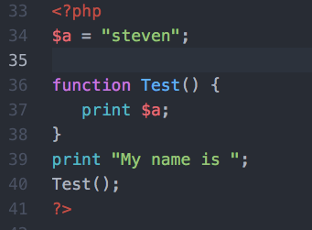
Function and Scope
<?php
$a = "Pekka";
function Test() {
print $a;
}
print ”My name is ”;
Test();
?>

Slide 14
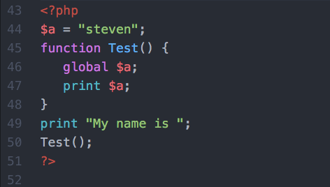
Scope
<?php
$a = "Pekka";
function Test() {
global $a;
print $a;
}
print ”My name is ”;
Test();
?>

Slide 15
Control Structures
If, else, elseif, switch
while, do-while, for
foreach
break, continue

Slide 16
PHP BASICS

Slide 17
Strings
Single quoted: 'this is a $variable'
Double quoted: "this is a $variable"
Heredoc:
  $str = <<<EOD
  Example of string
  spanning multiple lines
  using heredoc syntax.
  EOD;

Slide 18
String functions
A lot of functions…
  http://www.php.net/manual/en/ref.strings.php

Slide 19
Statements
Every statement ends with ;
  $a = 5;
  $a = function();
  $a = ($b = 5);
  $a++; ++$a;
  $a += 3;

Slide 20
Operators
Arithmethic: +,-,*,%
Setting variable: =
Bit: &, |, ^, ~, <<, >>
Comparison: ==, ===, !=, !==, <, > <=, >=

Slide 21
Ternary Operator
$variable = (1 < $x) ? 'value1' : 'value2';
Equals
if(1 < $x) {
$variable = 'value1';
}
else {
$variable = 'value1';
}

Slide 22
Logical Operators
$a and $b
$a or $b
$a xor $b
!$a;
$a && $b;
$a || $b;

Slide 23
String Operators
Two operators for strings: '.' and '.='
'.' – combining strings.
'.=' – appends string to the end.
Example:
$v= "Hello" . $b;
$v.= "Hello";

Slide 24
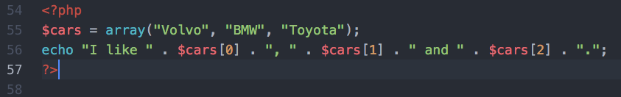
Arrays

Slide 25
CONTROL STRUCTURES

Slide 26
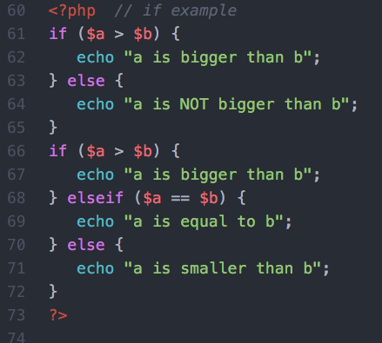
IF
<?php
if ($a > $b) {
echo "a is bigger than b";
} else {
echo "a is NOT bigger than b";
}
if ($a > $b) {
echo "a is bigger than b";
} elseif ($a == $b) {
echo "a is equal to b";
} else {
echo "a is smaller than b";
}
?>

Slide 27
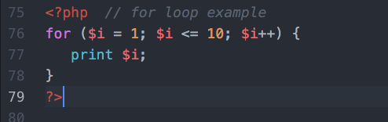
For
for ($i = 1; $i <= 10; $i++) {
print $i;
}

Slide 28
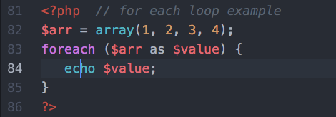
Foreach
$arr = array(1, 2, 3, 4);
foreach ($arr as $value) {
echo $value;
}

Slide 29
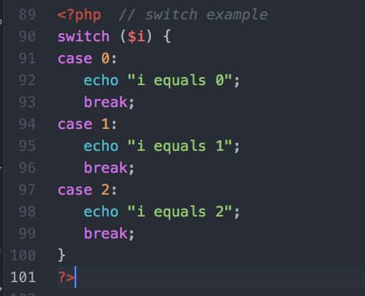
Switch
switch ($i) {
case 0:
echo "i equals 0";
break;
case 1:
echo "i equals 1";
break;
case 2:
echo "i equals 2";
break;
}

Slide 30
Twitter API using PHP
https://github.com/J7mbo/twitter-api-php

Slide 31
Linkify
https://github.com/steven-king/tweetLinkIt

Slide 32
